Slide 1
ABC Call Volume Trend Analysis
Varunika Naini

Slide 2


Agenda
A
Project Description
Approach
Tech-Stack Used
Insights
Results

Slide 3
Project Description
In this project, I delved into the world of Customer Experience (CX) analytics, specifically focusing on the inbound calling team of a company.
The provided dataset spanned 23 days and included various details such as the agent's name and ID, the queue time (how long a customer had to wait before connecting with an agent), the time of the call, the duration of the call, and the call status (whether it was abandoned, answered, or transferred).

Slide 4
Approach
By following a structured approach, I was able to analyze the CX team's inbound call performance thoroughly and provide valuable insights and recommendations for improvement.

Slide 5
1. Data Collection and Preparation:
Collected and reviewed the dataset spanning 23 days, which included details such as agent names and IDs, queue times, call times, call durations, and call statuses.
Cleaned and preprocessed the data to handle any missing values or inconsistencies.
2. Exploratory Data Analysis (EDA):
Performed an initial analysis to understand the distribution and basic statistics of key variables.
Visualized data to identify patterns and trends in call volume, queue times, and call durations.
Analyzed call statuses to understand the proportion of abandoned, answered, and transferred calls.
3. Time-Based Analysis:
Segmented call data into different time buckets (e.g., hourly intervals) to analyze variations in call volume and queue times throughout the day.
Identified peak calling times and durations to pinpoint periods of high demand.
4. Agent Performance Evaluation:
Evaluated individual agent performance based on metrics such as average queue time, call duration, and resolution rates.
Identified top-performing agents and those who might need additional training or support.
5. Call Outcome Analysis:
Analyzed the distribution and causes of abandoned calls.
Investigated factors contributing to high abandon rates during peak hours.

Slide 6

6. Customer Behavior Insights:
Derived insights into how queue times and call durations impact customer satisfaction and behavior.
Analyzed patterns to understand customer needs and expectations better.
7. Visualization and Reporting:
Created visual representations (charts, graphs) of call volume trends, queue times, and agent performance metrics.
Developed a comprehensive report summarizing key findings and insights.
8. Recommendations and Action Plans:
Proposed strategies to optimize staffing, including a manpower plan to reduce the abandon rate from 30% to 10% during peak periods.
Suggested a specific plan to address unanswered calls during night shifts to ensure 24/7 customer support.
Provided actionable recommendations for improving overall customer experience and agent efficiency.

Slide 7


Tech-Stack Used
In this project, I used Microsoft Excel to handle the entire analysis. I started by importing and cleaning the loan application data, utilizing Excel’s filtering, sorting, and data validation features.
For exploratory data analysis (EDA), I used Excel formulas, pivot tables, and charts to uncover patterns and relationships in the data. I also engineered new features with Excel functions to better predict loan defaults.
I used Microsoft Powerpoint to make presentation .

Slide 8
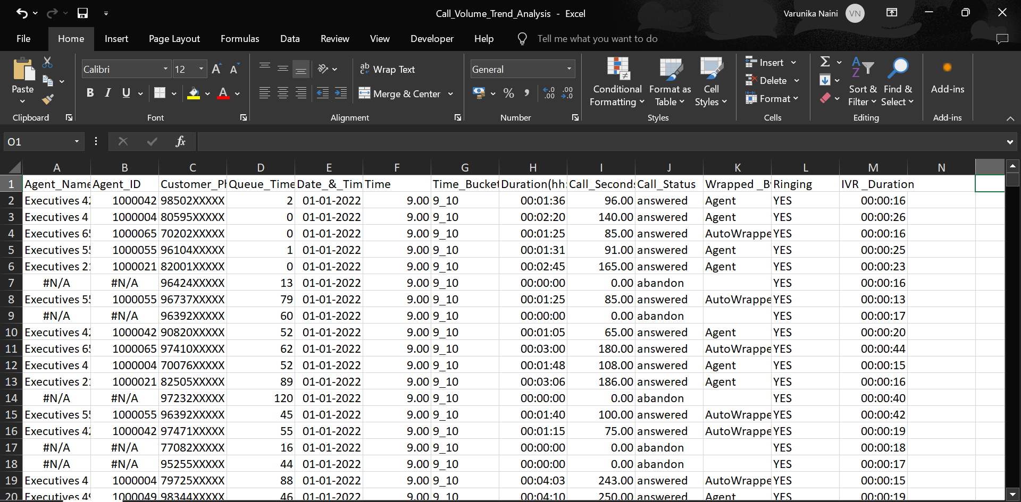
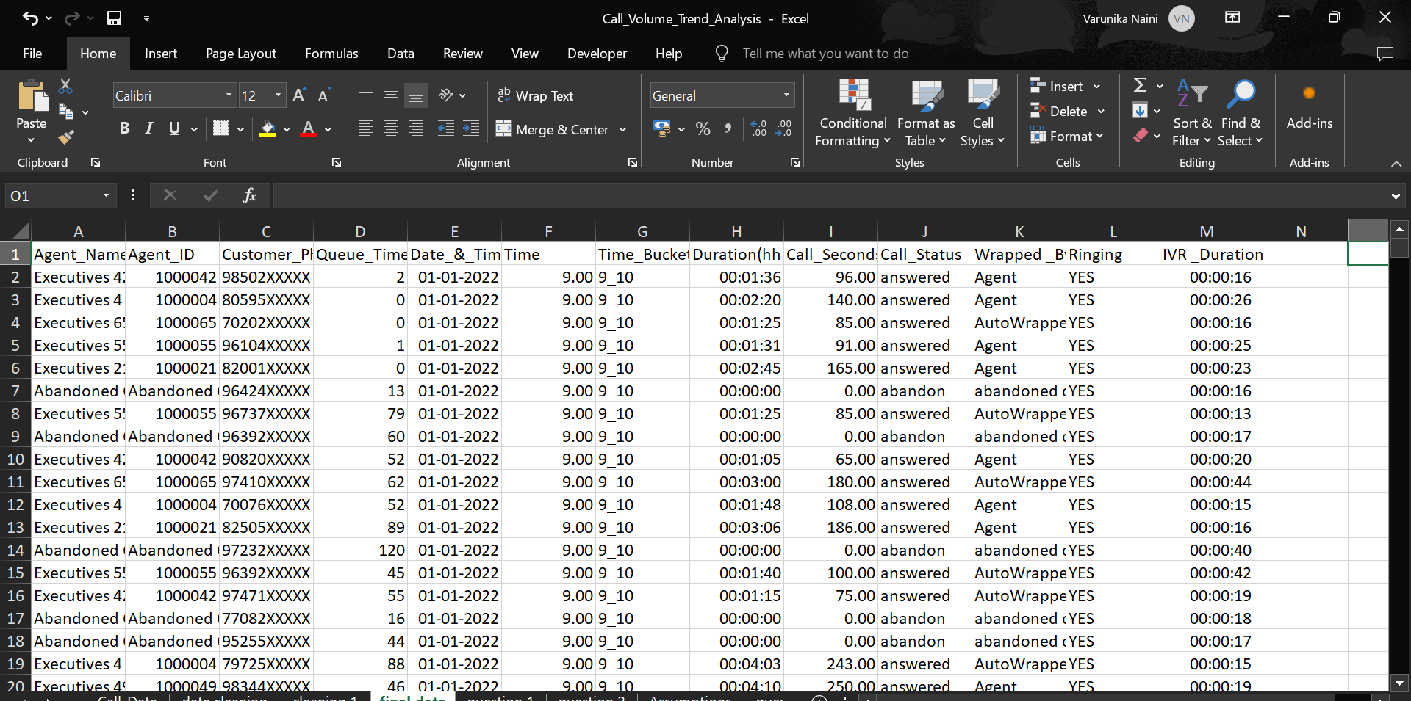
Data Cleaning
Data Before cleaning
Data After cleaning

Slide 9
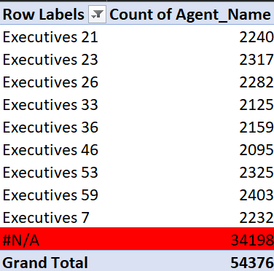
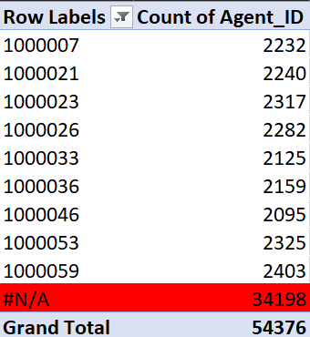
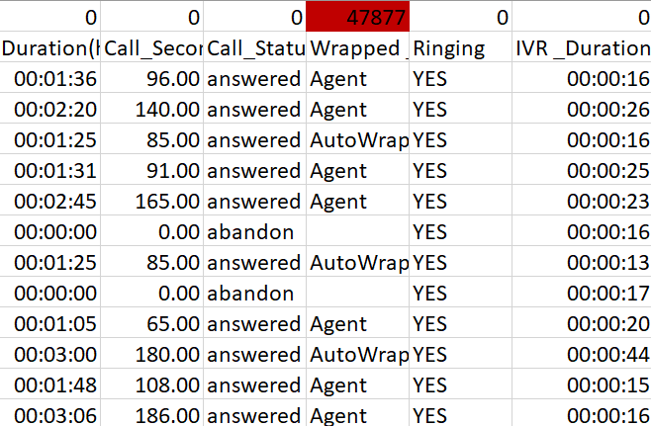
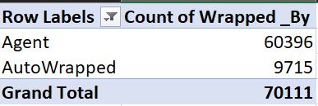
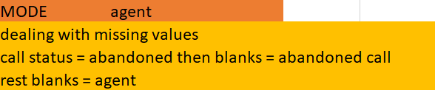
Counted blank cells using COUNTBLANK function
Replace the blanks in wrapped by by abandoned call for call status=abandon and rest of the blanks with Agent.
#N/A in columns Agent_name and Agent_id are replaced by Abandoned call.
By doing these , the data is ready for further analysis.

Slide 10
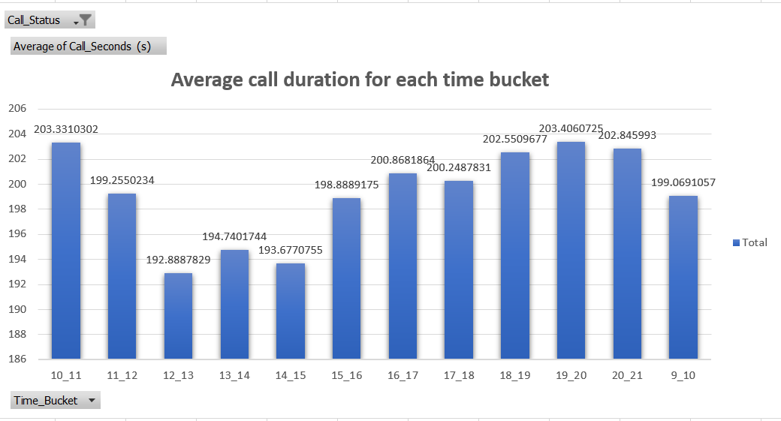
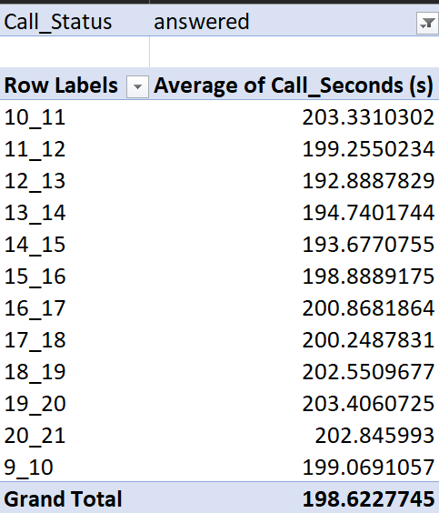
Insights
Question 1 : What is the average duration of calls for each time bucket?

Slide 11
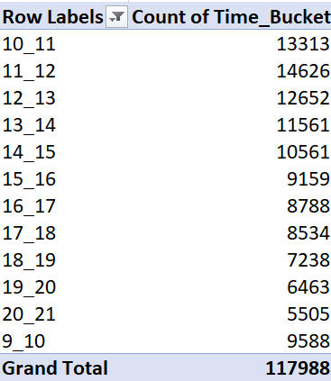
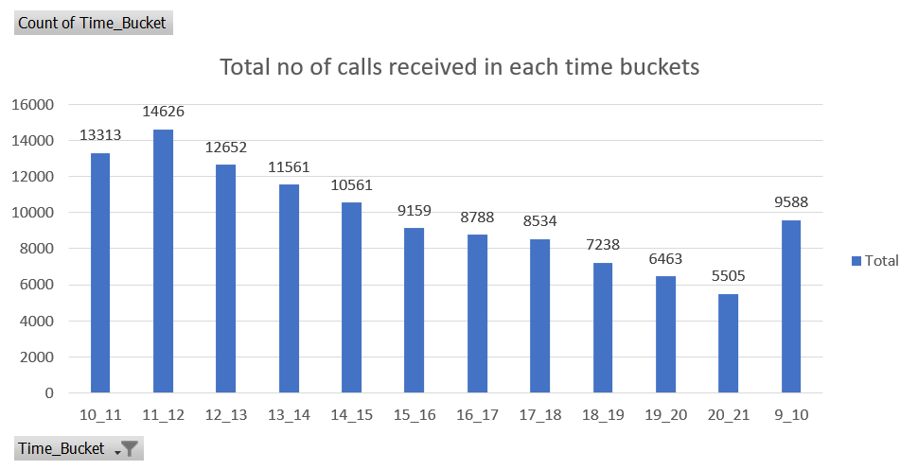
From the following graph we can observe that the average call duration doesn’t vary much from one time bucket to other .
Highest average call duration is for 7 – 8 pm and the least is for 12-1pm , this might be due to lunch break .
Total average duration is 198.62 sec .
Question 2: Can you create a chart or graph that shows the number of calls received in each time bucket?

Slide 12
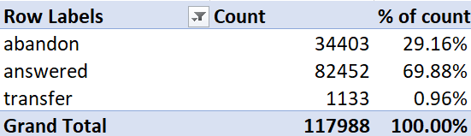
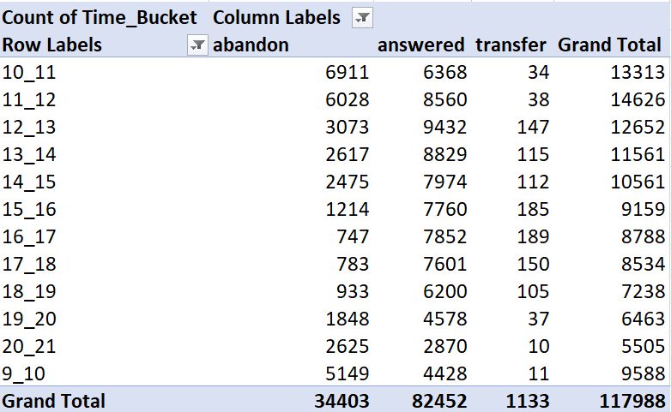

From the following graph we can observe the no of calls recieved in each time bucket.
Highest average call duration is for 11 am – 12 pm ( might be due to people are free around that time )
and the least is for 8-9 pm -> this might be due to completion of working hours .
Question 3: What is the minimum number of agents required in each time bucket to reduce the abandon rate to 10%?

Slide 13
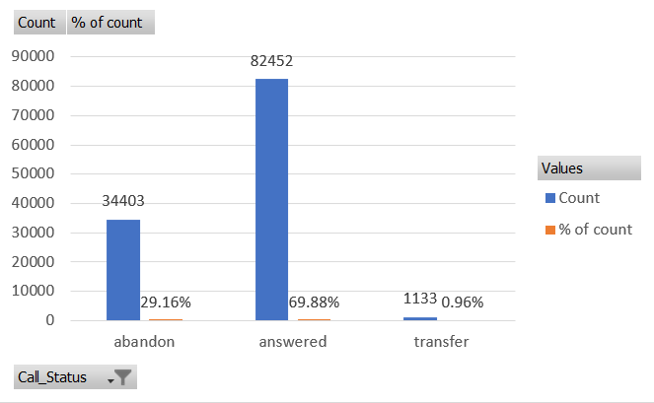
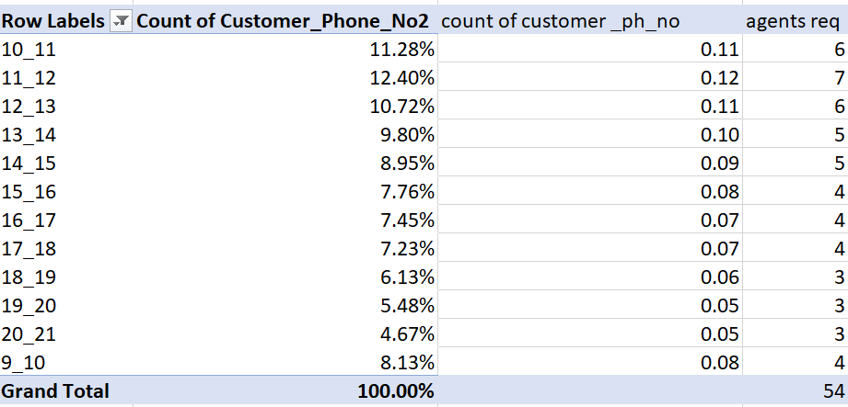
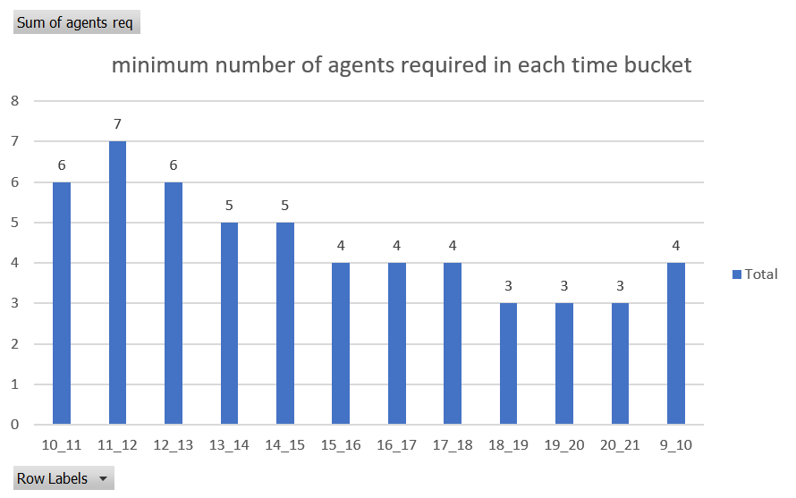
From the following graph we can observe the minimum number of agents required in each time bucket to ensure that at least 90 out of 100 calls are answered.
Highest is needed for 10 am – 12 pm ( might be due to people are free around that time )
and the least is for 8-9 pm -> this might be due to completion of working hours .

Slide 14
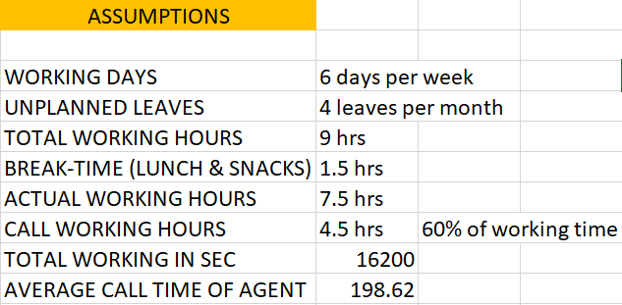
Assumptions

Slide 15
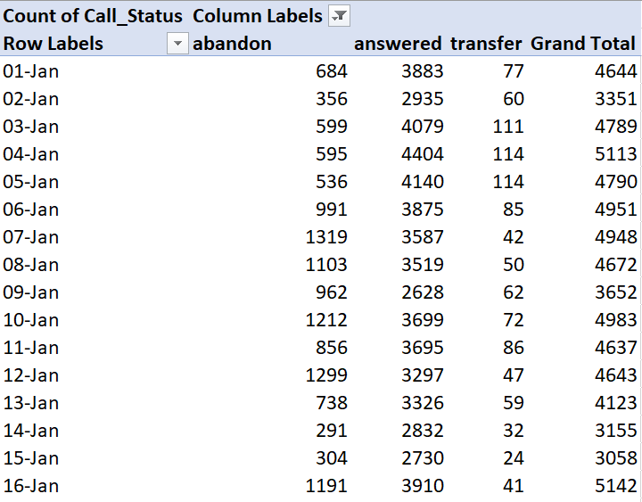
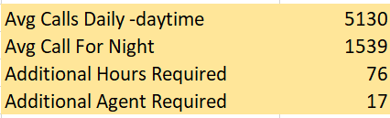
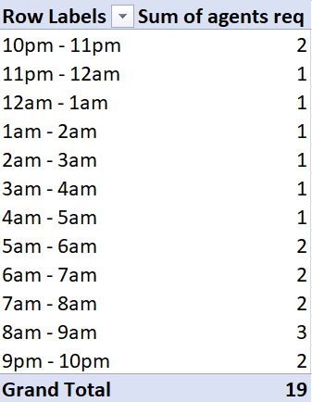
Question 4 : Propose a manpower plan for each time bucket throughout the day, keeping the maximum abandon rate at 10%.

Slide 16
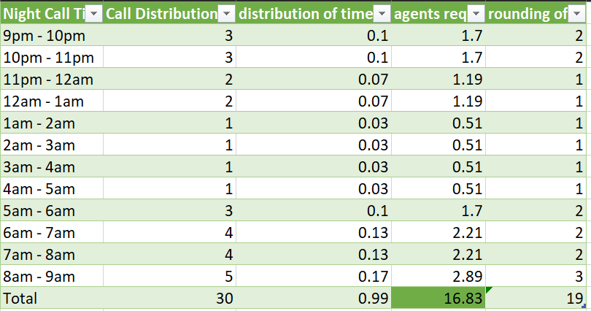
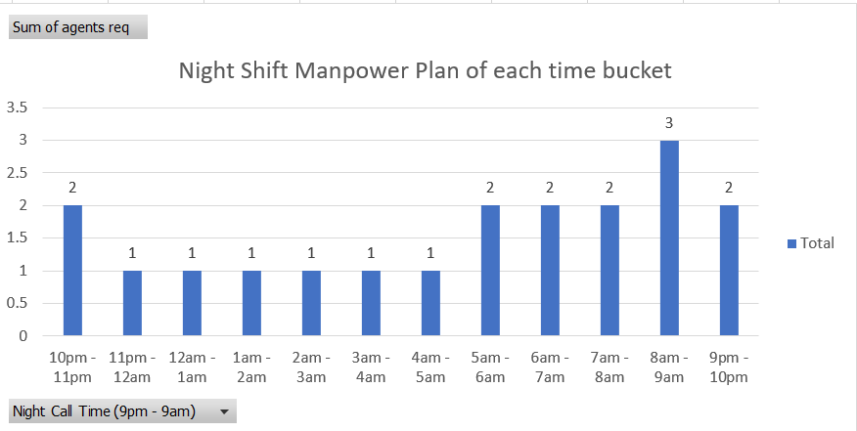
From the following graph we can observe manpower plan for each time bucket throughout the day, keeping the maximum abandon rate at 10%.
Highest is needed for 8 am – 9 am and the least is for 11 pm – 5 am .
First, I estimated the time distribution by dividing each call distribution by the total number of calls, which was 30. The number of agents required for each time bucket is determined by the 15 * time distribution

Slide 17
Conclusions
Customers call the least in the evening.
As a result, the organization can reduce the number of personnel answering calls at that time.
The organization can appoint 17 customer service representatives for the night shift.
Employees who work from 9 am to 9 pm In order to answer more calls, the manager may change the shift of some employees from 5 am to 2 pm And others from 2 pm to 11 pm.
The company may someday shift the employees to the night shift which will provide continuous coverage and effective call handling throughout the day.
The organization can also divide the employers into three categories so that agents are always available 24 hours.

Slide 18
Result
I gained valuable insights into call durations across different time buckets, which facilitated better resource management and planning.
By providing visual representations of call volume trends over time, I enabled more informed decision-making regarding staffing requirements.
Additionally, I proposed a manpower plan aimed at reducing the abandon rate from 30% to 10% during peak periods, significantly improving customer satisfaction.
Another manpower plan was proposed to address unanswered calls during the night, ensuring a better customer experience round the clock.
The comprehensive project report serves as a valuable resource for the leadership team to understand and optimize the performance of the ABC company's inbound call center.

Slide 19
Thank you
Varunika Naini
varunikaanaini@gmail.com
LINK TO EXCEL SHEET
LINK TO VIDEO PRESENTATION

